Slide 1
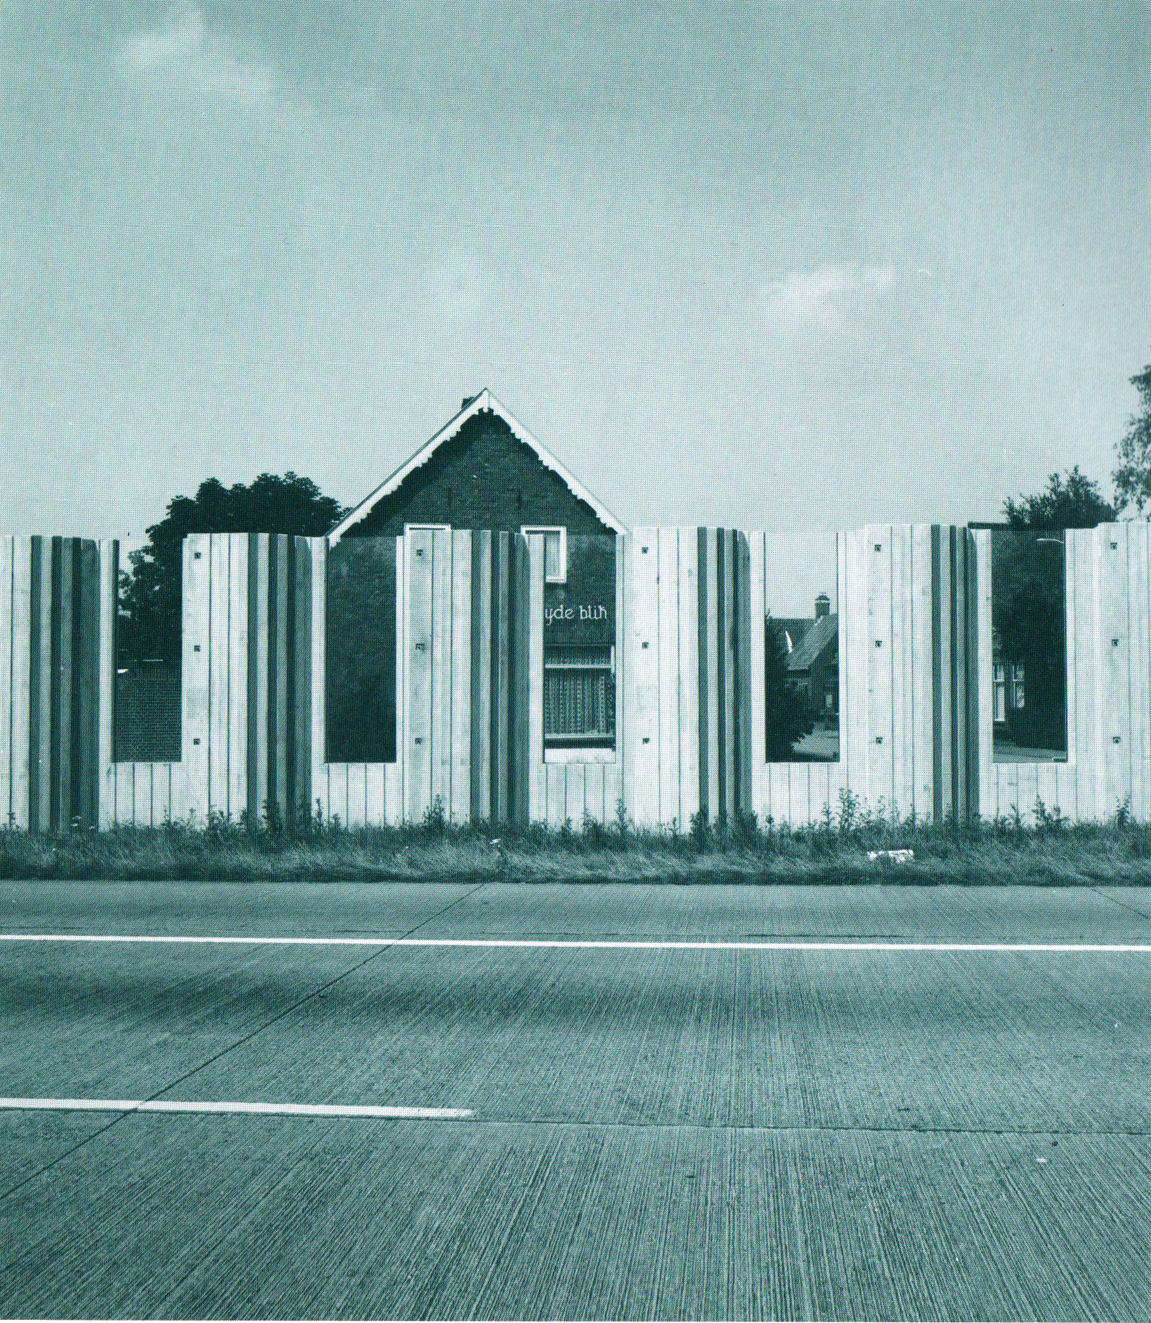
Road noise in the Netherlands
Estimating the willingness-to-pay for noise reduction

Slide 2
Research questions
What are households willing to pay (or paying) for noise reduction?
What are (affected) households willing to pay for a sound barrier wall

Slide 3
Social and academic context
External costs of road noise
€17 billion annualy in Europe (CE Delft, 2011)
Missing market for tranquillity
WTP for noise reduction
Noise abatement policy up to where: Marg. Benefit of Abatement = Marg. Cost of Abatement

Slide 4
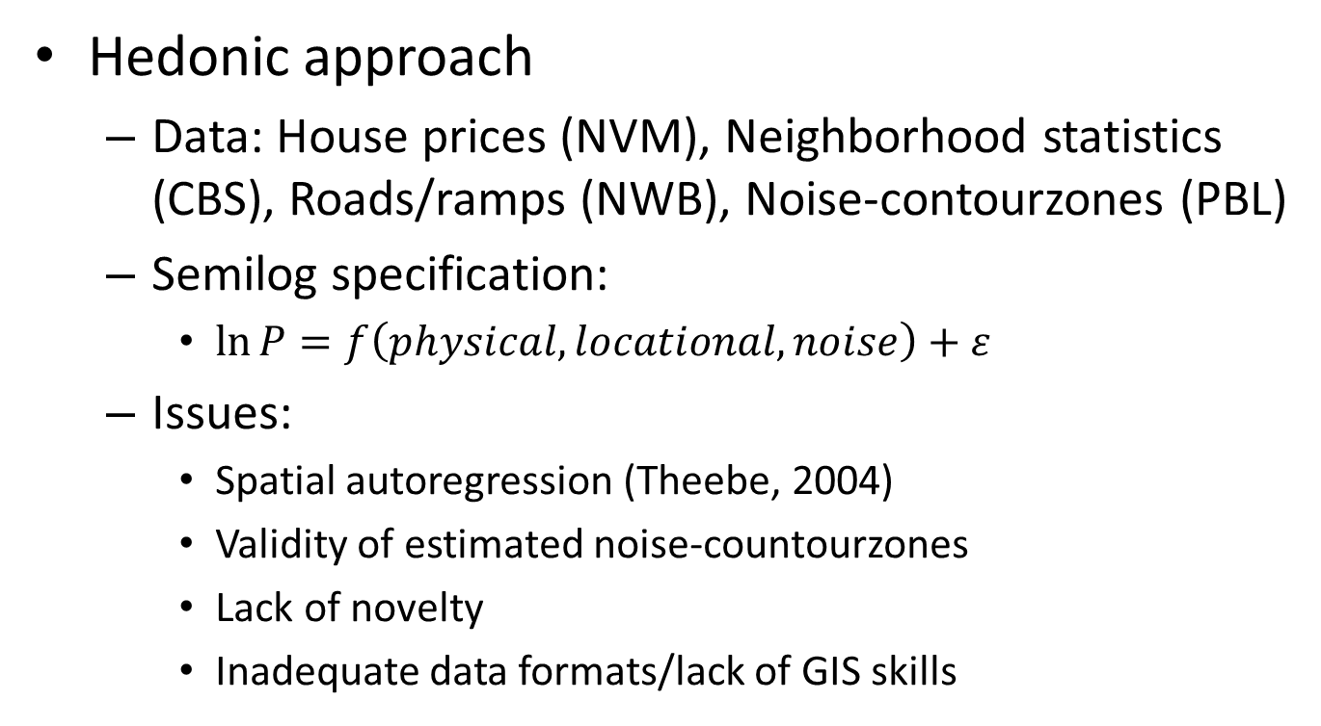
Noise Depreciation Index
Hedonic approach
Data: House prices (NVM), Neighborhood statistics (CBS), Roads/ramps (NWB), Noise-contourzones (PBL)
Semilog specification:
$\ln{P}=f\left(physical, locational, noise\right)+ε$
Issues:
Spatial autoregression (Theebe, 2004)
Validity of estimated noise-countourzones
Lack of novelty
Inadequate data formats/lack of GIS skills

Slide 5
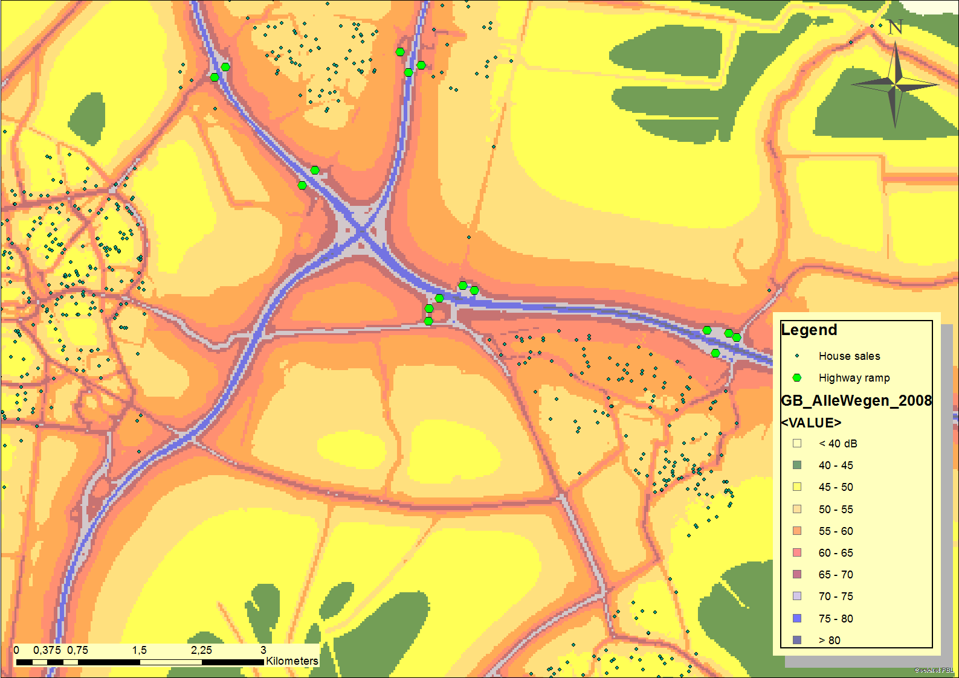
Data on map

Slide 6
Sound barrier walls
Hedonic approach: Repeat sales
Data: House prices (NVM), Neighborhood stats (CBS), Roads/ramps (NWB), Noise-barriers (GWV)
Repeat sales: Only houses that are sold both before and after sound barrier construction
Issues:
Lack of data: construction year of noise barriers
Why are noise barriers constructed? (location characteristics, possible confounders, IV approach?)

Slide 7
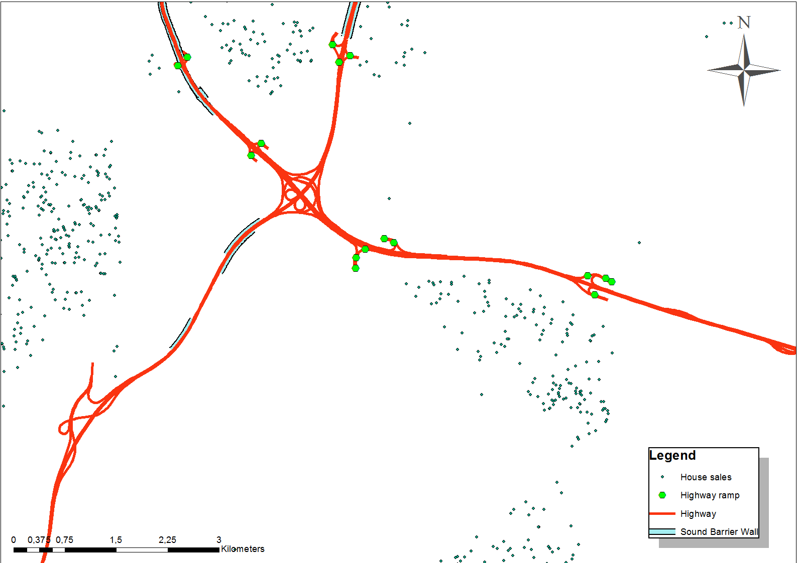
Data on map

Slide 8
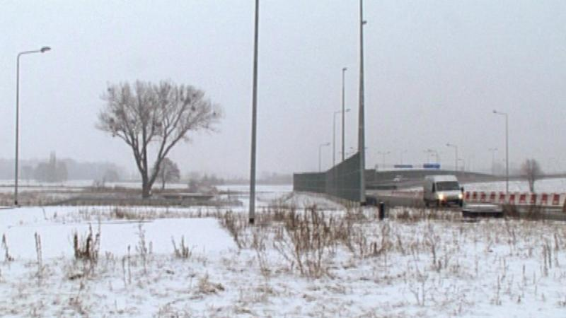
Sound barriers in Poland

